Slide 1
SMART CAR PARKING SYSTEM USING IOT
Under guidance of
Mr/Dr. NATARAJ N,
ME
BIT,
Sathy.
202IT210- SAMYUKTHA K R P
202IT242- SURYA S S
202IT124- DANUSHMATHI P
202IT231- SRIVARSHAN M

Slide 2
Abstract
The idea of smart cities has acquired a lot of popularity in latest days. The concept of a smart city today appears to be feasible, due to advancement of the Internet of Things. In order to maximise the performance and dependability of urban infrastructure, consistent attempts are being taken in the domain of IoT. IoT is addressing issues such as road congestion, limited automobile parking spaces, and accident prevention. We describe an IoT-based cloud-integrated smart parking system in this research. The proposed Smart Parking system entails the installation of an IoT module on-site, which is utilised to monitor and communicate the availability of each individual parking place. A android application is also available, which allows people to check the status of the parking spaces and reserve one correspondingly. A increased view of the system architecture is also described in the article. The paper concludes with a discussion of the system's operation in the form of a use case that demonstrates the accuracy of the provided model

Slide 3
Problem Statement Addressed
The lots of folks have difficulty parking their cars. We may also state that it is one of the primary issues that millions of people throughout the world are dealing with.Because of the increase in number of vehicles and their larger sizes, individuals generally spend the most time looking for parking spots. It is unavoidable for people to keep up with the advance in science. Individuals generally are having difficulty parking their vehicles in city parking spaces

Slide 4
Proposed Solution to the Problem Addressed
Smart parking development entails the creation of an IoT-based system that transmits information about available and occupied parking spaces via a web/mobile application. Each parking space has an IoT gadget, which includes sensors and microcontrollers. The user is given a real-time update on the availability of all parking spaces and is given the option to choose the best one.We launched an internal study effort to investigate the technologies underpinning the smart parking solution. The core concept was to create smart parking utilising the Internet of Things and ultrasonic sensors, with available parking spaces shown in a web app.

Slide 5
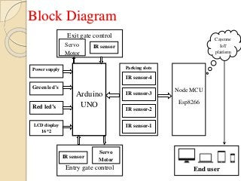
Block Diagram and/or Circuit Diagram

